Slide 1

Department of Computer Applications Presentation On GGI Achievers Session : AUG-DEC(2023) PROJECT-5th Sem
Presented By :
ARYAN
Branch: BCA 5th
Roll Number: 2112630

Slide 2
Contents
Introduction
Aim and Objective of the Project
Software Requirement
Type of Tools and Technology to be used
Process Description
Time Frame
Benefits of the Project
Future Scope
Methodology or Planning of the Work
Conclusion
References

Slide 3
Introduction
It will be a dynamic and user-friendly Social Community website designed exclusively for students and faculty of GGI, for communication, collaboration, and connection within their campus community.
It will be mainly used for showcasing the Achievements by the Students of GGI
Posts can be filtered by required time

Slide 4
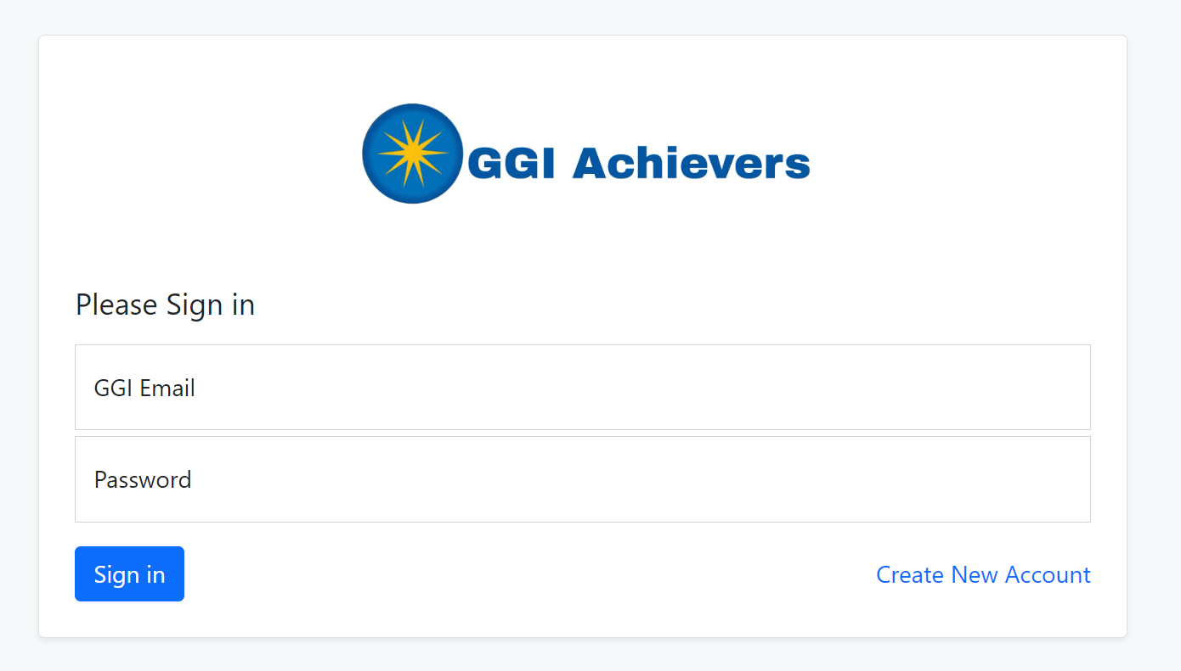
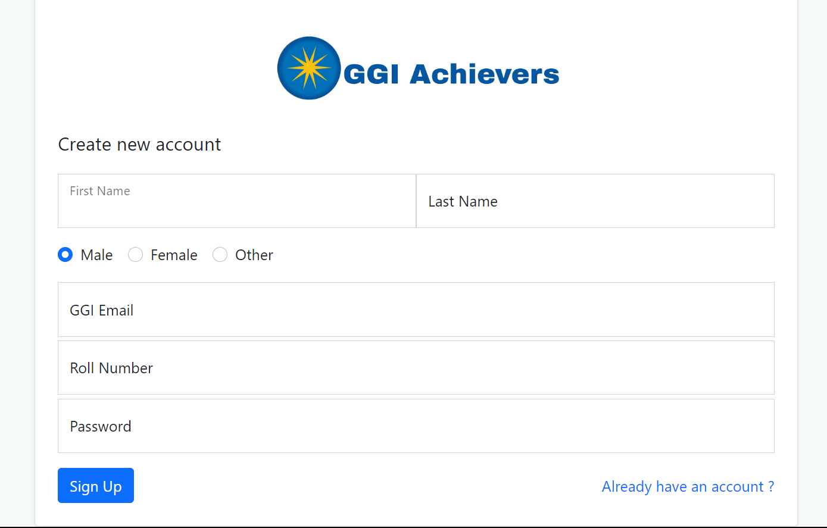

Slide 5
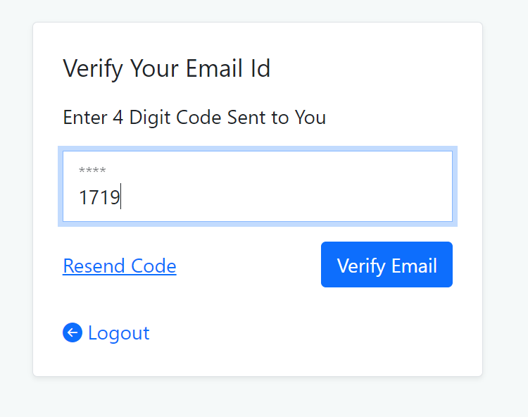
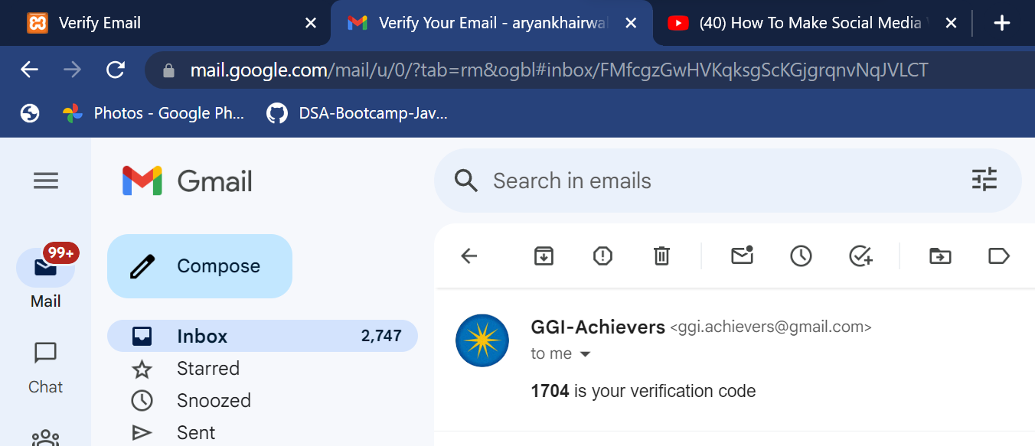
Email verification
Exclusively for students and faculty of GGI Only

Slide 6
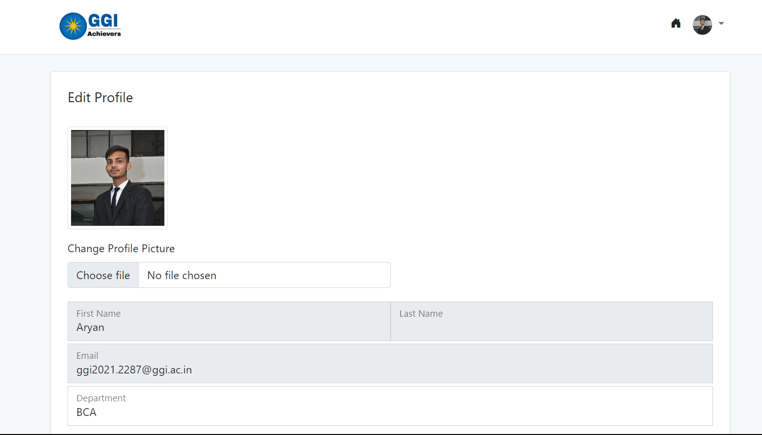
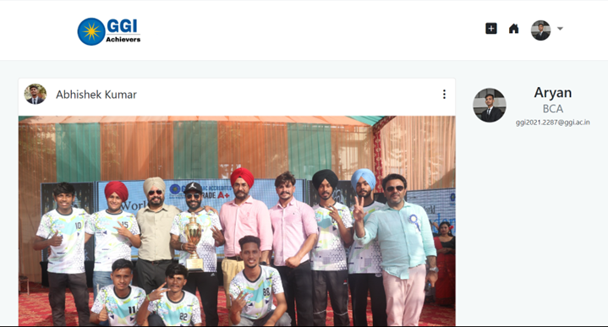
Home Page

Slide 7
Aim and Objective of the Project
The Objective of the project is to maintain the records of achievements of the students of our college that would help to inspire the other students and the required data can be easily retrieved according to a particular time period.

Slide 8


Software Requirements
Visual Studio Code :
Visual Studio Code, also commonly referred to as VS Code,[12]
is a source-code editor made by Microsoft with the Electron
Framework, for Windows, Linux and macOS.[13] Features
include support for debugging, syntax highlighting, intelligent
code completion, snippets, code refactoring, and embedded Git.
XAMPP : XAMPP is a free and open-source cross-platform web server solution stack package developed by Apache Friends,[2] consisting mainly of the Apache HTTP Server, MariaDB database, and interpreters for scripts written in the PHP and Perl programming languages.

Slide 9
Types of Tools and Technology to be used
HARDWARE REQUIREMENT
System used 64-bits OS
Memory-4GB more than
SOFTWARE REQUIREMENT
PHP (backend)
HTML, CSS Bootstrap (frontend)
MySQL (database connectivity)
PLATFORM
Browser

Slide 10

Time Frame
Time Frame Required for various stages of Project Implementation:-
• Frontend- It took near about more than 2 weeks.
• Backend- It will take 2 week for completing the backend.

Slide 11
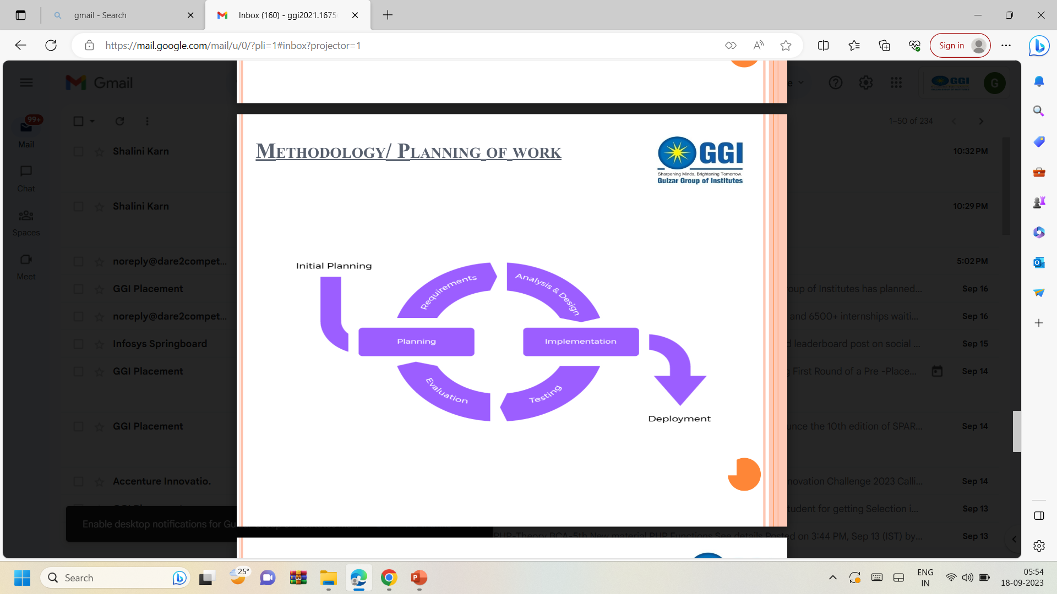
Methodology/Planning of Work

Slide 12
Process Description
Define projects requirements: The first step is to define the project requirements. • Data analysis: The collected data needs to be analyzed. • Integration: Project needs to be integrated with the existing security. • Testing: It needs to be tested to ensure that it meets the project requirement. • Deployment: Once the system has been tested, it can be deployed • Maintenance: Finally it needs to be maintained to ensure its continued operation

Slide 13
Future Scope
College can invest in the development of this system.
This community website can be further converted into an Android Application and published on Google Play store.
It can be upgraded for better communication by adding chat feature.

Slide 14
Conclusion
The proposed system maintains the details of the students required by the college.
This proposed system will keep the track of the required information for the students account in the system.
It helps user in efficient searching of information.

Slide 15
Thank You !

